Slide 1

INSTITUTE - UIE
DEPARTMENT- ACADEMIC UNIT-2
Bachelor of Engineering (Computer Science & Engineering)
Subject Name: Introduction to Problem Solving
Code:22CSH-101
Flowcharts
DISCOVER . LEARN . EMPOWER

Slide 2


Introduction to Problem Solving
Course Objectives
The course aims to provide exposure to problem-solving through programming.
The course aims to raise the programming skills of students via logic building capability.
With knowledge of C programming language, students would be able to model real world problems.

Slide 3



Course Outcomes
CO Number | Course Outcome
CO1 | Remember the concepts related to fundamentals of C language, draw flowcharts and write algorithm/pseudocode.
CO2 | Understand the way of execution and debug programs in C language.
CO3 | Apply various constructs, loops, functions to solve mathematical and scientific problem.
CO4 | Analyze the dynamic behavior of memory by the use of pointers.
CO5 | Design and develop modular programs for real world problems using control structure and selection structure.

Slide 4
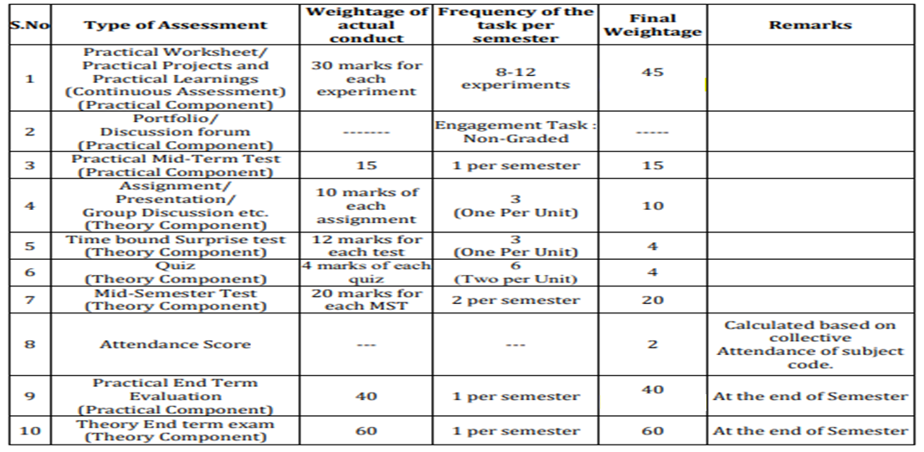
Scheme of Evaluation

Slide 5
What
A flow chart is a graphical or symbolic representation of a process. Each step in the process is represented by a different symbol and contains a short description of the process step. The flow chart symbols are linked together with arrows showing the process flow direction.
Why
This diagrammatic representation illustrates a solution model to a given problem. Flowcharts are used in analyzing, designing, documenting or managing a process or program in various fields.

Slide 6
Uses of Flowchart:
Planning a new project.
Documenting a process.
Modeling a business process.
Managing workflow.
Auditing a process.
Mapping computer algorithms.
Data management.
Chemical and process engineering.

Slide 7
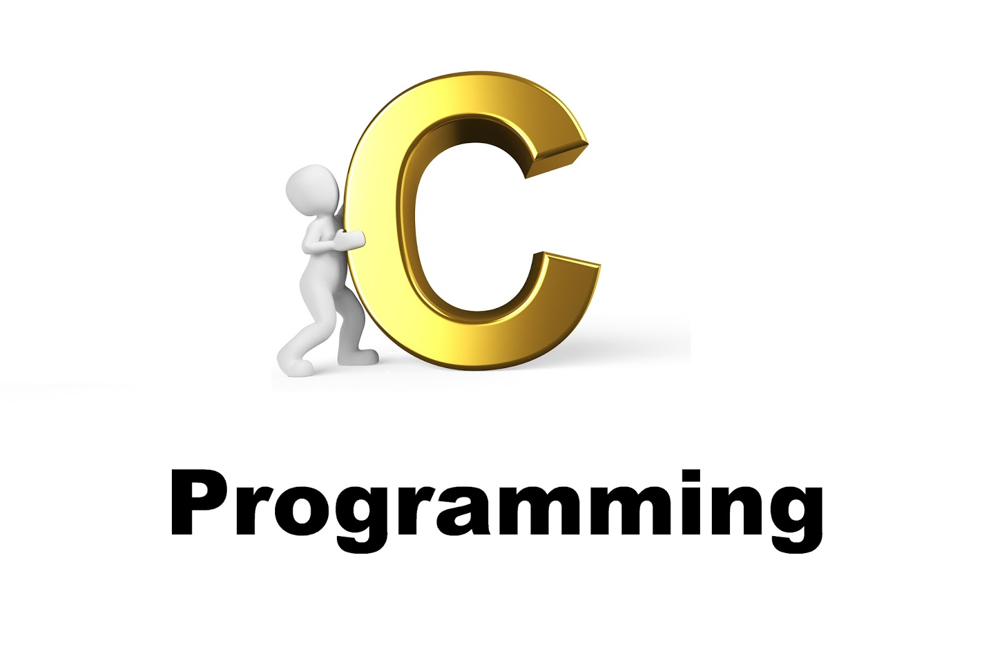
CONTENTS
Space for visual (size 24)
Introduction to Flowcharts
Symbols used in flowcharts
Example Flowcharts
Notes:
Computer in the diagram is 3rd generation computer. The period of third generation was from 1965-1971. The computers of third generation used Integrated Circuits (ICs) in place of transistors. A single IC has many transistors, resistors, and capacitors along with the associated circuitry. The main features of third generation are −
IC used
More reliable in comparison to previous two generations
Smaller size
Generated less heat
Faster
Lesser maintenance
Costly
AC required
Consumed lesser electricity
Supported high-level language

Slide 8

FLOWCHART
A flow chart is a graphical or symbolic representation of a process. Each step in the process is represented by a different symbol and contains a short description of the process step.
It uses several geometrical figures to represent the operations, and arrows to show the direction of flow.
The flow chart symbols are linked together with arrows showing the process flow direction.

Slide 9
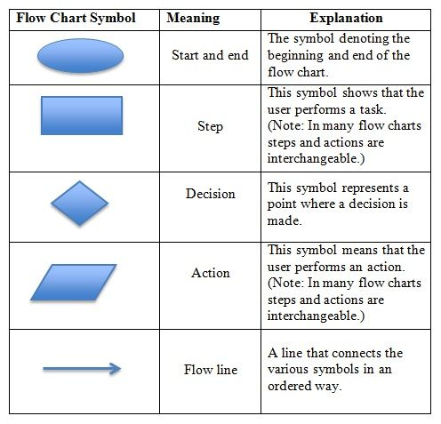
Flowcharts Symbols:

Slide 10
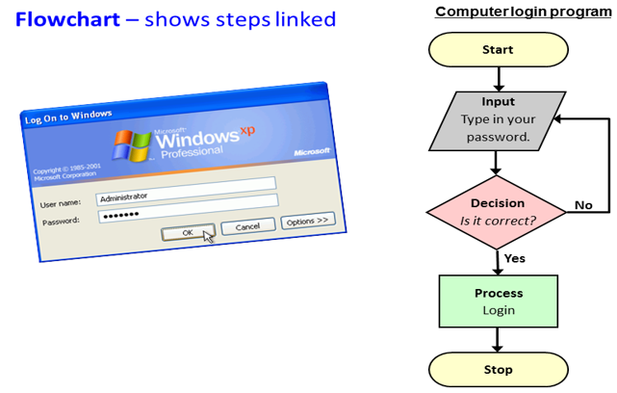

Slide 11
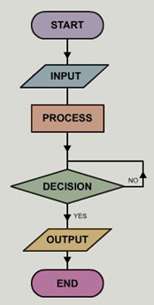
IDEA OF FLOWCHART
Oval shaped symbol is used to denote the start/end
of program
This symbol is used to show the I/O performed
This symbol is used to show the process
This symbol represents the point where decision is
made
This symbol is used to show the I/O performed
Oval shaped symbol is used to denote the start/end
of program

Slide 12
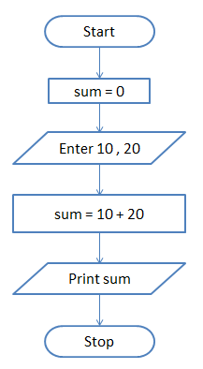
EXAMPLES OF FLOWCHART AND ALGORITHMS
Example: Add 10 and 20
Start
Initialize sum = 0 (PROCESS)
Enter the numbers (I/O)
Add them and store the result in sum (PROCESS)
Print sum (I/O)
Stop
Figure 1.9 flowchart for addition of two numbers

Slide 13
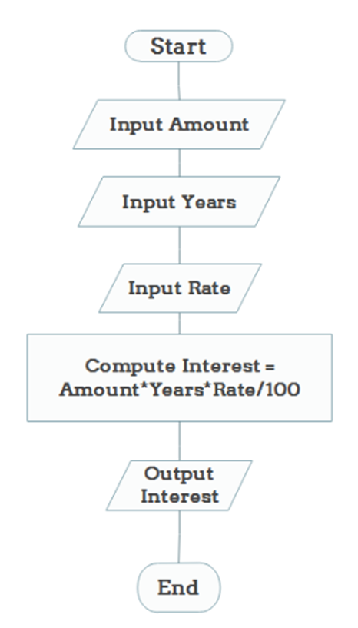

EXAMPLE: CALCULATE INTEREST OF BANK DEPOSIT
Algorithm:
Step 1: Start
Step 2: Read amount,
Step 3: Read years,
Step 4: Read rate,
Step 5: Calculate the interest with formula Interest=Amount*Years*Rate/100
Step 6: Print interest
Step 7: Stop
Figure 1.10 flowchart to calculate interest rate

Slide 14
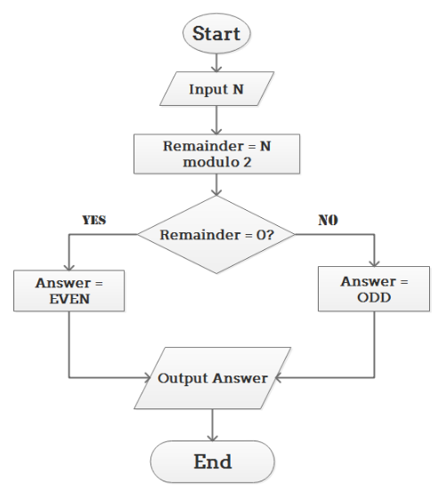
DETERMINE WHETHER THE NUMBER IS EVEN OR ODD
Algorithm:
Step 1: Start
Step 2: Read number N,
Step 3: Set remainder as N modulo 2,
Step 4: If remainder is equal to 0 then number N is even, else number N is odd.
Step 5: Print output.
Step 6: End
Figure 1.11 flowchart for even/odd

Slide 15
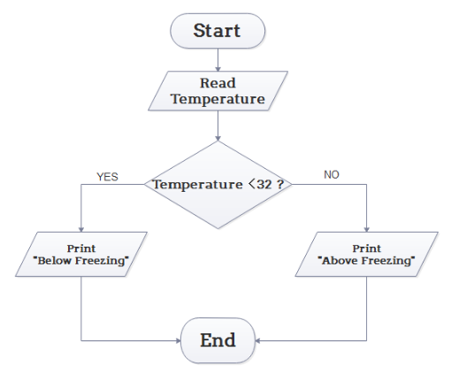
DETERMINE WHETHER TEMPERATURE IS ABOVE OR BELOW FREEZING POINT
Algorithm:
Step 1: Start
Step 2: Input temperature,
Step 3: If it is less than 32,
then print "below freezing point",
otherwise print "above freezing point“
Step 4: End
Figure 1.12 flowchart to determine temperature

Slide 16
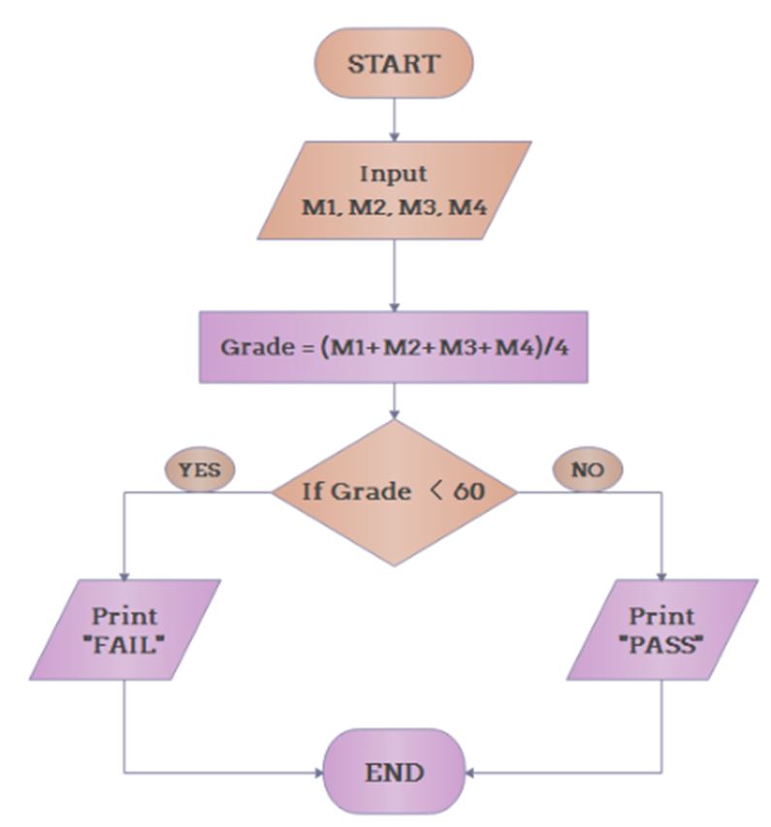
DETERMINE WHETHER STUDENT PASSED THE EXAM OR NOT
Algorithm:
Step 1: Start
Step 2: Input grades of 4 courses M1, M2, M3 and M4,
Step 3: Calculate the average grade with formula Grade=(M1+M2+M3+M4)/4
Step 4: If the average grade is less than 60, print "FAIL", else print "PASS".
Step 5: End
Figure 1.13 flowchart to print pass/fail

Slide 17
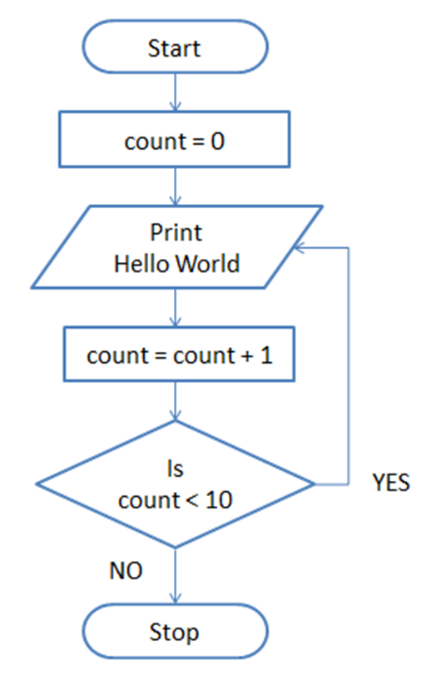
Print Hello World 10 times
Start
Initialize count = 0 (PROCESS)
Print Hello World (I/O)
Increment count by 1 (PROCESS)
Is count < 10 (DECISION)
if YES go to step 2 else Stop
Stop
Figure 1.14 flowchart to print hello 10 times

Slide 18
Key Differences Between Algorithm and Flowchart
An algorithm involves a combination of sequential steps to interpret the logic of the solution. In contrast, a flowchart is the pictorial illustration of the algorithm.
A flow chart is more understandable as compared to the algorithm.
The algorithm is written in a language that can be perceived by humans. On the other hand, the flowchart is made up using different shapes and symbols.
There are no stringent rules are implemented in the algorithms while the flowchart is abode by predefined rules.
Errors and bugs are easily detected in the algorithm as compared to the flow charts.
Flow charts are simple to create. On the contrary, the construction of the algorithm is complex.

Slide 19

ADVANTAGES OF FLOWCHART
It is a convenient method of communication.
It indicates very clearly just what is being done, where a program has logical complexities.
A key to correct programming.
It is an important tool for planning and designing a new system.
It clearly indicates the role-played at each level.
It saves the inconveniences in future and serves the purpose of documentation for a system.
It provides an overview of the system and also demonstrates the relationship between various steps.
Facilitates troubleshooting.
It promotes logical accuracy.
It makes sure that no logical path is left incomplete without any action being taken.

Slide 20
DISADVANTAGES
The flowchart is a waste of time and slows down the process of software development.
The flowchart is quite costly to produce and difficult to use and manage.
Flowcharts are not meant for man to computer communication.
Sometimes the Complex logic of the program logic is quite complicated to draw out on by using different defined shapes. In that case, flowchart becomes complex and clumsy. This will become a pain for the user, resulting in a waste of time and money trying to correct the problem
If you need to modify or alternate the process then it will be very hard to do in the flowchart. Because either you will have to erase the end of the flowchart or start.

Slide 21
Summary
In this lecture we have discussed about need and use of flowcharts
In this lecture we have learnt how to design flowchart , how to use specific symbol .
We have also discussed some advantages , disadvantages and applications of Flowcharts

Slide 22
Frequently Asked question
Q1: What is a sub-process in a flowchart?
Answer: Sometimes complex processes are broken down into smaller sub-processes for clarity. So a flowchart can point to a different sub process within its flow. The predefined process symbol is used to show such sub-processes.
Q2: How are flowcharts used in computer programming?
Answer: A computer program consists many processes and flows. Flowcharts are used to visualize the processes and make it understandable for nontechnical people. They are also used to visualize algorithms and comprehend pseudo code which is used in programming.
Q3: Which online tools can I use to create flowcharts?
Answer: There are numerous tools which you can find easily. Some of them are: Raptor, Visual Paradigm, Gliffy, and Creately

Slide 23
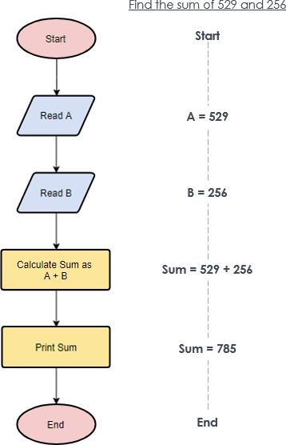
Q4: Draw the flowchart to represent the sum of two numbers.

Slide 24
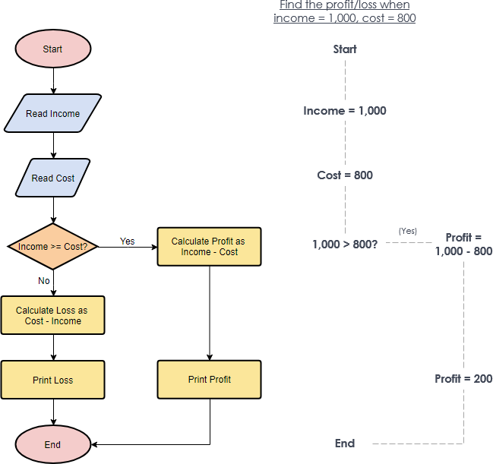
Q5 Draw the flowchart to calculate profit and Loss.
Answer: Flowchart –Calculate Profit and Loss
The flowchart example below shows how profit and loss can be calculated.

Slide 25


Assessment Questions:
The symbol denotes ______
a) I/O
b) Flow
c) Terminal
d) Decision
2. The box denotes? a) Decision b) Initiation c) Initialization d) I/O
3. Design a flowchart to check leap year
4. Design a flowchart to find sum of n natural numbers
5. Design a flowchart of Quadratic equation

Slide 26
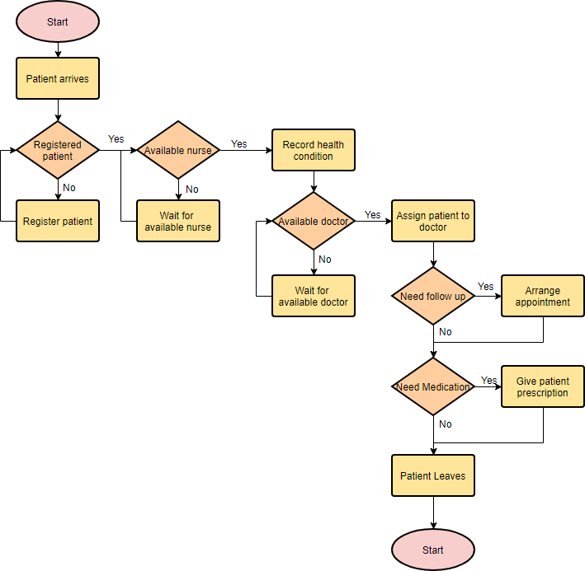
Discussion forum.
Students please have a look at this Medical Service Flowchart and try to improve it.

Slide 27

REFERENCES
Reference Books:
[1] Programming in C by Reema Thareja.
[2] Programming in ANSI C by E. Balaguruswamy, Tata McGraw Hill.
[3] Programming with C (Schaum's Outline Series) by Byron Gottfried Jitender Chhabra, Tata McGraw Hill.
[4] The C Programming Language by Brian W. Kernighan, Dennis Ritchie, Pearson education.
Websites:
https://medium.com/@warren2lynch/a-comprehensive-guide-for-flowchart-over-50-examples-785d6dfdc380
https://www.geeksforgeeks.org/an-introduction-to-flowcharts/
https://www.programiz.com/article/flowchart-programming
YouTube Links:
Introduction to Creating Flowcharts: https://youtu.be/SWRDqTx8d4k
Introduction to Flowchart Symbols: https://youtu.be/kxZJv56BxU8

Slide 28
THANK YOU

